Slide 1
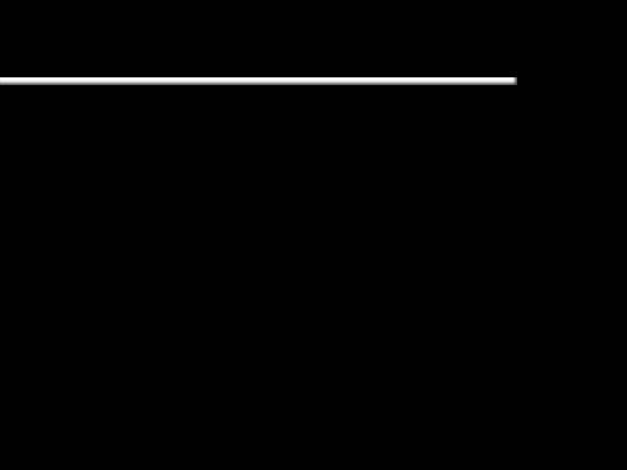
What Child is This?
What Child is this who, laid to rest
On Mary’s lap is sleeping?
Whom angels greet with anthems sweet,
While shepherds watch are keeping?

Slide 2
What Child is This?
This, this is Christ the King,
Whom shepherds guard and angels sing;
Haste, haste, to bring Him laud,
The Babe, the Son of Mary.

Slide 3
What Child is This?
Why lies He in such mean estate,
Where ox and ass are feeding?
Good Christians, fear, for sinners here
The silent Word is pleading.

Slide 4
What Child is This?
This, this is Christ the King,
Whom shepherds guard and angels sing;
Haste, haste, to bring Him laud,
The Babe, the Son of Mary.

Slide 5
What Child is This?
So bring Him incense, gold and myrrh,
Come peasant, king to own Him;
The King of kings salvation brings,
Let loving hearts enthrone Him.

Slide 6
What Child is This?
This, this is Christ the King,
Whom shepherds guard and angels sing;
Haste, haste, to bring Him laud,
The Babe, the Son of Mary.

